Slide 1
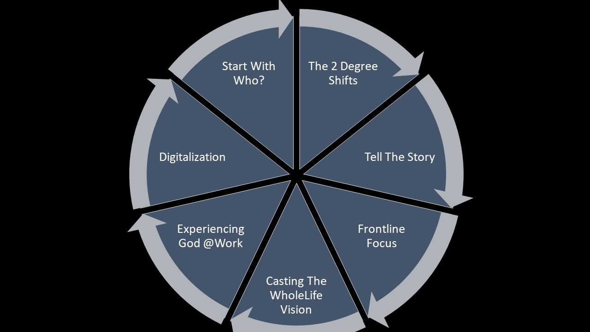
7 elements of the integration
Mod.1
Mod.1
Portal
Mod.2
Enhancement
Mod.3

Slide 2
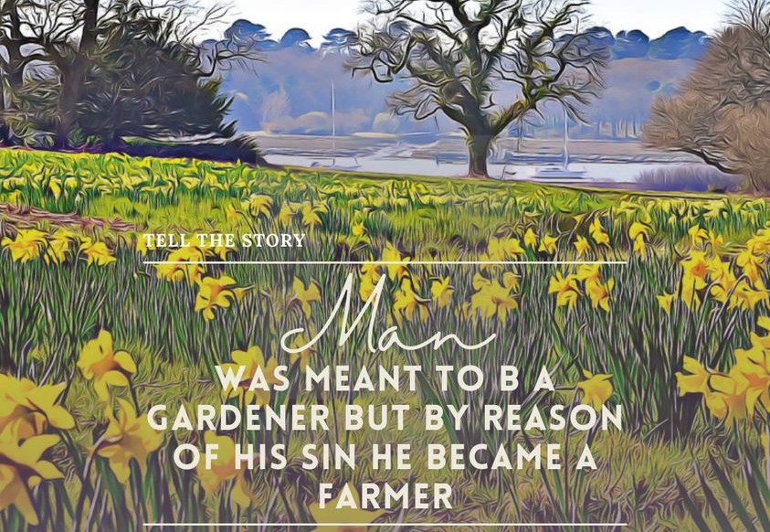
Tell the Story
End
Beginning

Slide 3
The
Story

Slide 5
Your original Design, The Dignity of work, & the cultural mandate- Who? Why?
Work is not a product of the fall; work is seen performed by God at the creation. It is God’s inherent nature. God created work for a reason.
God at work, the Hebrew word mlkh is the same as human ordinary work.

Slide 6
Your work matters to God and god matters to your work
Hence, your work becomes God’s work

Slide 7
In the beginning Who? Why?
Strategic Intent
What
Outcome-goal
How. The Process that set them apart
Why
The Purpose
Who
The core identity
‘In Christ’
Our Gifts
Doing
Being
The Original Design addresses the ‘Who and Why’ quadrant of the strategic intent of the model. Understanding work helps to know who we are through our calling and the purpose of our life in Christ.

Slide 8
Observation 1: work is a blessings and a necessity of life
God created work as part of the blessedness of the garden. Work is not the product of the fall. Material world matters to God.
Work in its ‘truest sense’ gives meaning to life when it is subservient to God, and we are designed for it [through our vocation] to work.
We merely don’t need the money from work to survive, we need the work itself to thrive and live fully as human. Work is that important!
Without work life is Void….

Slide 9
Observation2: God the worker porter, builder, carpenter,
God delights in his work – for what he has made was good and very good (Gen1:31,2:1). Creativity is in your design. Creativity is a work and rest rhythm
God care for his creation, hardworking worker. He forms man (Gen.2:7), plant a garden for him and waters it (Gen.2:6,8)- so that it can sustained life, gave him a wife (Gen.2:21-22)….Yet he…..
Commission workers, fill the earth, subdue and have dominion over.. (Gen.1:28). Gen.2:15- Work it and keep it. Psalms 145-God feeds us through the labour of farmers.

Slide 10
Fill and Subdue it and have dominion… [1:28] the job descriptions
Fill… Subdue and Dominion- assertion of the will.
God love productivity and accountability [work], He only gave them seed bearing plants and fruits with seeds – cultivate (2:5) (we also corporation-rain brought by God) and they are to eat of them [1:29]. We need to take control and be accountable- this is part of our Job description- just like how God work at it. (1:2,4,7)
[2:5] God need human to cultivate them even the raw materials were in place. The garden is perfectly balanced and a resourced starting point- no as tamed as you think. God needed us to creatively cultivate it by working at it [1:30] with his as the creator (2:5).
God partner with human in cultivating the garden, to make it productive and he gave animals for them to rule over them- man named them, empowers them with authority [2:19-20] [1:28-30]

Slide 11
[1:28] Fill, subdue, dominion make us…. A steward of his creation [vocation]
But Remember: This is a stewardship role it does not belongs to us! The principle which governed all work and business in the world! Stewards are not owner, but are ‘trustee”- where we manage another’s property or finances affairs [Gen.2:15- work and keep]
As trustee- how you manage, what is the goal and purpose must be clearly spell out- this is the scope of our work. [1:28-30 job description]
Hence terminology like ‘capital, technology innovation, supply chain, operations, logistics, etc are his means of cultivation and we becomes Co–Creator to steward the creation.
Be humble to manage God’s resources and God’s world, don’t be greedy. Share the resources.

Slide 12
OBSERVATION 3: We are to imitate God [vocation] Inherit God characters, mindset, gifts and talents Call and Charisma (gifts/talents) form the call in our life.
1. We are made in God image and likeness
[Gen.1:26-27]
Worker (Gen. 2:2-3): we see him doing the work of creating and resting from it – effective: fruitful work.
Relationship with the Godhead- Let us made man [1:26], the ‘trinity God’ making man out of love, so love must flow out from our work. God cooperate and participate with us. Saved (called us) to serve the world.
Productivity (Cultivation), Empowerment and Creativity are utmost important to God. Need to do your work well!

Slide 13
[1:28] Fill, subdue, dominion make us to Cultivate
Cultivating would mean rearranging/reordering God’s resources (raw materials) in creativity and assertiveness- Gardener
If we are doing what God is doing, taking chaos, the raw materials, and make something beautiful- hence it is good and very good. then what we do must be good and very good and it matters.
What we are doing, brain surgery or sweeping the rubbish, fetching grandkids to school, our work becomes God’s work.
We are called to cultivate his creation by a clear purpose through our work who is both at the core of our design and with dignity fulfilling the cultural mandate- fill, subdued, and have dominion over….

Slide 14
Dignity of Work
Being in the Image of God (Called to him) = Dignity in our work: Doing God’s work
The problems with the Greeks:
Demeaning view of work: Philosophers are better than manual labor- hierarchy of work is created, lower paying job, lower status work
Material world is evil. Be like the gods- be in contemplation rather than work, body is evil, spirit is good.
3. God only gave human a ‘job description’- an office [1:26, 28,2:19 Ps.8:4-8;James 3:7]. While plant simple “teem and reproduce”, when we are called to subdue and have dominion!

Slide 15
Dignity of Work
Being made in the Image of God and Imitating him, we become his vice regents through our Call.
Being made in the image of God, given to royalties in Egypt and Mesopotamia, it was never applied to common people! but the bible called everyone royalty for all are created in His image.
Even manual labors are dignified, God does ‘manual labor’ by forming man from the dust and plant a garden (Gen.2:8). Soil his hand…
God came into the world-
Greek: Philosopher King, Romans: State-man, but in the Bible, Christian God came as a carpenter (worker).
Material world is not evil, was corrupted due to sin, and God is renewing it, to sustain humanity and bringing it into perfection.

Slide 16
Observation 4: work is in our design: the Freedom of work- via a constraint concept work and rest Rhythm
1.Freedom is not the absence of constraint. For we need to honor the boundary of the nature.
2.True freedom is about finding the right restrictions that fit to our realities of our own nature.
Commandment sets us free, the tree in the garden sets us free to what we are build for.
Car work well within the manual.
Fish will die if it is removed from the water.

Slide 17
Work is in our design: Freedom of work- constraint
Hence limit allow us to live out our designs, so that we enjoy freedom,
The work and rest rhythm is important. Rest is not the absence of work, but an attitude of the mind or soul in which you are able to contemplate and enjoy things as they are in themselves, without regards to their value or their immediate utility (purpose) – Pieper.
You will not have a meaningful life without work and rest, but you cannot say that your work is the absolute meaning to your life. [Paradox of work]

Slide 18
Quote: Pieper says leisure [rest] means:
Leisure is the condition of considering things in a celebrating spirit…. Leisure lives on affirmation. It is not the same as the absence of activity…. It is rather like the stillness in the conversation of lovers, which is fed by their oneness…. And as it is written in the Scriptures, God saw, when “he rested from all the works that He had made” that everything was good, very good (Genesis 1:31), just so the leisure of man includes within itself a celebratory, approving, lingering gaze of the inner eye on the reality of creation. Sit back and admire our work…. Work is meaningful.

Slide 19
how do you value work +rest rhythm Give example!
Did God create food only to provide for necessity [nutrition] and not also for delight and good cheer? So too the purpose of clothing apart from necessity [protection] was comeliness and decency. In grasses, trees, and fruits, apart from their various uses, there is beauty of appearance and pleasantness of fragrance…. Did he not, in short, render many things attractive to us, apart from their necessary use? John Calvin.

Slide 20
What about when you say? ‘I hate my work’ Do you know what you hate about it?- burdensome, toil
Remember, we are built for it and freed by it. Despite the grim reminder of the curse of sin acting on it, by itself it is not a curse.
Vocation is a cooperation and participation of God and us in a complex way, but ultimately it is outside us – God in charge in calling us.

Slide 21
Christian understanding of our work
[It] is that work is not, primarily, a thing one does to live, but the thing one lives to do. It is, or it should be, the full expression of the worker’s faculties …. the medium which he offers himself to God –Dorothy Sayers

